Slide 1
Electric Technocracy Vision
2025/08/22

Slide 2
Introduction and Vision
Economy, Basic Income, and Tax Exemption
01
02
CONTENTS
Government by Artificial Superintelligence (ASI)
Social and Technological Impacts
03
04

Slide 3
Introduction and Vision
01

Slide 4

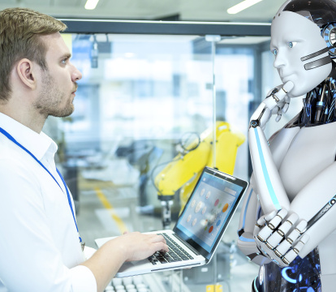
The Electronic Technocracy
A Revolutionary Government Form
The electronic technocracy represents a revolutionary shift in governance. It aims to break away from the traditional nation - state model, bringing a new era of unified global rule.
Abolishing Nation - States
Under this system, the long - standing concept of nation - states will be abolished. This change is intended to eliminate barriers and conflicts often associated with national boundaries.

Slide 5

The Electronic Technocracy
Establishing a Unified World Government
Instead of multiple nation - states, a single unified world government will be established. This government can streamline decision - making and resource allocation on a global scale.

Slide 6

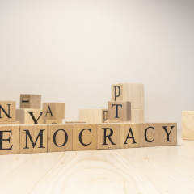
Global Governance and ASI
ASI Support for World Government
Advanced Superintelligent AI (ASI) plays a crucial role in the world government. It analyzes complex global problems, such as climate change and resource shortages, and presents effective solutions.
Direct Digital Democracy for Citizens
Citizens can actively participate in global governance through Direct Digital Democracy. They can vote on policies and express their opinions directly via digital platforms.

Slide 7

Global Governance and ASI
Enhanced Decision - Making Process
With ASI's analysis and citizens' participation, the decision - making process of the world government becomes more informed and inclusive. This can lead to more effective global governance.

Slide 8
Economy, Basic Income, and Tax Exemption
02

Slide 9
Economic System Taxes and UBI
01
02
Taxation on AI and Robots
Corporate Tax Adjustments
As AI and robots increasingly replace human labor, taxing them can help balance the economic impact. For example, some countries are considering a 10 - 20% tax on robot usage in industries.
Companies that heavily rely on new technologies should pay higher taxes. Tech giants like Google and Amazon may face a 5% increase in corporate tax rates to redistribute wealth.

Slide 10

Economic System Taxes and UBI
Universal Basic Income (UBI) Implementation
UBI can be funded by the taxes mentioned above. In Finland's pilot project, around 2,000 unemployed citizens received €560 monthly, improving their financial stability.

Slide 11
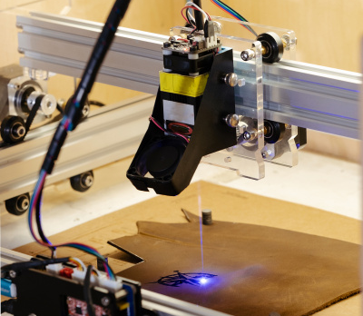
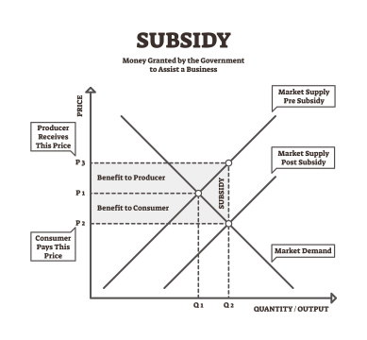
The Post - Scarcity Economy
Technological Abundance
Advanced technologies such as 3D printing and automation have led to an abundance of goods. For instance, 3D printers can rapidly produce various products at low cost.
Shift in Economic Model
The traditional supply - demand model is changing. In the post - scarcity economy, access to resources becomes more important than ownership, like in the sharing economy.

Slide 12

The Post - Scarcity Economy
Challenges and Opportunities
While resource abundance offers opportunities for human development, it also poses challenges such as redefining work. Approximately 40% of jobs may be automated in the next decade.

Slide 13
Government by Artificial Superintelligence (ASI)
03

Slide 14


Foundations of the State Form
Definition of ASI in Electric Technocracy
ASI in the state form of electric technocracy refers to advanced AI systems integrated into the governance. They assist in decision - making and resource allocation.
Core Concept of ASI
The core concept is to use AI's data - processing and analytical capabilities to optimize the operation of the electric - based state, ensuring efficient power use and distribution.

Slide 15
Foundations of the State Form
Role of ASI
ASI plays a crucial role in predicting power demands, managing energy grids, and formulating policies to balance supply and demand, enhancing overall state efficiency.

Slide 16
Direct Digital Democracy (DDD)
Idea Development Process
Voting Process
In the DDD system, citizens can submit ideas through digital platforms. For example, a community might propose a new energy - saving project via an online portal.
Voting occurs digitally, allowing citizens to express their opinions on various proposals. A high - speed internet - based system ensures quick and fair voting results.

Slide 17
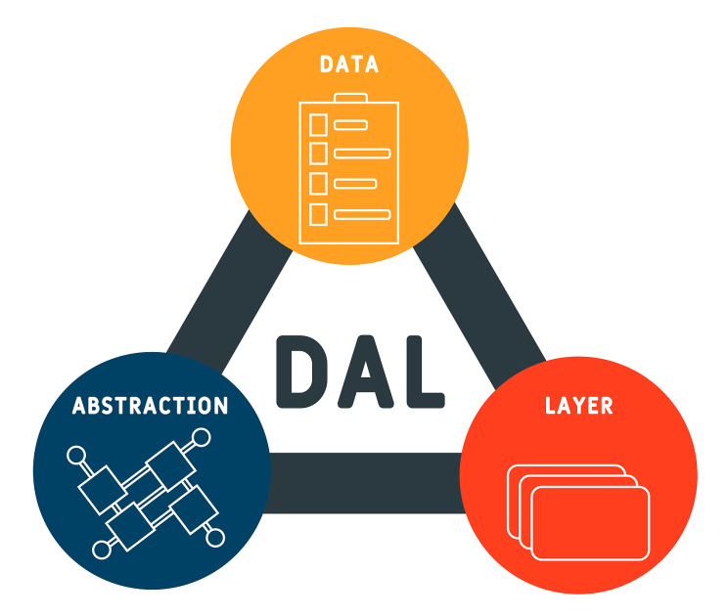
Direct Digital Democracy (DDD)
Parallel Work of ASI
ASI works in parallel during DDD. It analyzes the feasibility of ideas, provides data - driven insights, and helps in predicting the impact of proposed policies.

Slide 18
Social and Technological Impacts
04

Slide 19


AI - Financed Social State & UBI
Goal
Financing
The goal of an AI - financed social state and UBI is to ensure social fairness and economic stability. For example, it can reduce poverty rates and provide a basic living standard for all citizens.
Financing mainly comes from AI - driven economic growth, such as increased corporate profits due to AI efficiency improvements. Tax revenues from AI - related industries can be a significant source.

Slide 20
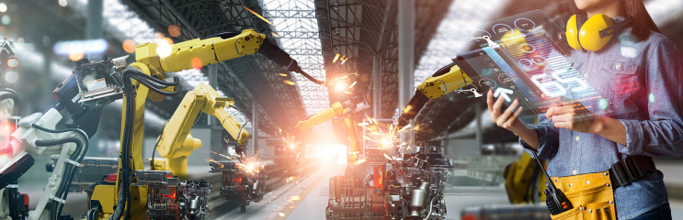

AI - Financed Social State & UBI
Benefits
Challenges
Benefits include enhancing social welfare, promoting personal development as people have more time for education and self - improvement. It also stimulates consumer spending, boosting the economy.
Challenges involve accurately calculating the UBI amount and ensuring fair distribution. There may also be resistance from some taxpayers and concerns about reducing work incentives.

Slide 21
Technological Basis and Future Trends
01
02
AI Technology
Robotics
AI can automate complex tasks, improve decision - making in electric technocracy. For instance, it can optimize power grid operations, reducing energy waste by up to 20%.
Robots can perform dangerous and repetitive tasks in the electric field, like maintaining high - voltage lines. This improves safety and reduces human error.

Slide 22
Technological Basis and Future Trends
Quantum Computing
Quantum computing can handle large - scale data analysis in real - time, enabling more accurate power demand forecasting and better resource allocation.
Impact on Future
These technologies will lead to a more intelligent, efficient, and sustainable electric technocracy, with reduced costs and enhanced reliability.

Slide 23
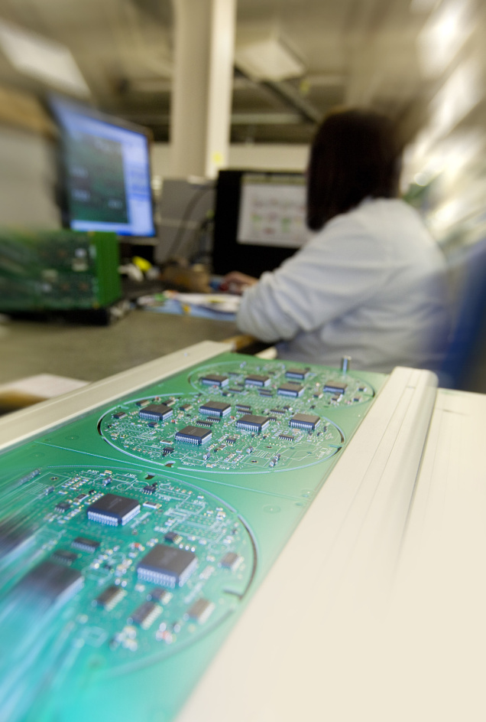
Conclusion
Summary of Main Points
The electric technocracy combines AI - financed social policies and advanced technologies. It aims for social fairness, economic stability, and efficient power management.
Potential for a Better Future
With continuous technological progress, electric technocracy has the potential to create a more equitable, sustainable, and prosperous future for society.

Slide 24
THE END

